Slide 1
Project Management and Management Tools
Geography 176C
Thanks to: Sean Benison

Slide 2
What is Project Management?
Framework and tools for planning, managing, and completing large-scale projects
New professional field
Bottom line: IT tools can apply to all stages of project management and improve it

Slide 3
Formal Description
A way of thinking systematically about the behavior of people at work in an organizational setting
A vocabulary of terms, concepts, theories, and methodologies that allow work experiences to be clearly analyzed, shared, and discussed
Techniques for dealing with many of the problems that commonly occur in the work setting (Springer 2006)

Slide 4
Why It’s Important
Tremendous growth in recent years
Tools are increasingly used in businesses and organizations
Measurable benefits
New career possibilities
Especially critical in large projects such as GIS
Source and systems integration

Slide 5
History
“Scientific” approach to industry and business in early 20th Century
  Ford, Taylor, etc
Advent of very large projects in Second World War
  Realization that new management techniques were needed for such projects

Slide 6



Outcomes:
WW2 Fighter
Projects
P-51 Mustang
Outstanding
P-38 Lightning
Fairly Good
P-39 Airacobra
Poor

Slide 7
History (2)
Project management techniques developed in 1950s-1960s
  Primarily military projects
Increasing popularity in variety of businesses & organizations from 1980s-present
  Creation of “Project Manager” as distinct occupation
  Project Management Professional (PMP) and other certifications

Slide 8
Paradigm
General systems theory (Bertalanffy 1936)
Tools and diagrams formalized for GST
Flow diagrams -> Programming
Led to structuring of industry, e.g. vertical and horizontal
Critical points
JIT planning
Also, complex systems theory

Slide 9
Basic Tools
Organization
  Project Lifecycle
  Project Proposal
  Work Breakdown Structure
Scheduling and visualization
  Gantt Chart
  PERT
  Critical Path Method

Slide 10
Organization
Tools

Slide 11
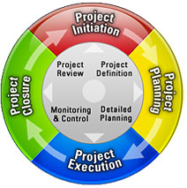
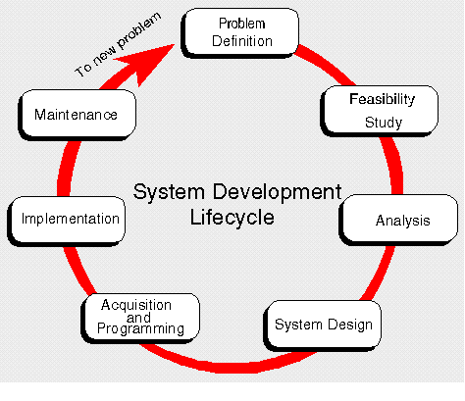
Project Lifecycle
Understanding and planning for entire lifespan of project
Four basic stages
  Initiation
  Planning
  Execution
  Closure

Slide 12
Project Proposal
Document outlining and arguing for proposed project
Provides foundation for project planning
Often in response to Request for Proposal (RFP)
  Open or targeted call for proposed projects to address given need

Slide 13
Project Proposal (2)
Typical components
  Problem definition
  Mission, goals, and scope
  Stakeholders
  Benefits
  Resources needed (incl. budget)
  Tasks and milestones (SOT)
  Risks
  Outcome/deliverables

Slide 14
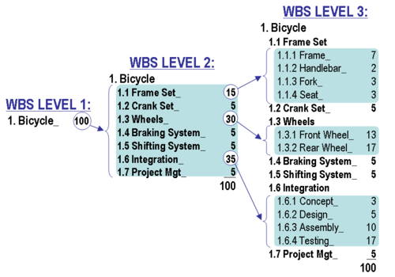
Work Breakdown Structure
Defines and organizes work elements of project
Work broken down into set of major tasks
Values assigned for portion of total work represented by each task

Slide 15
Scheduling and
Visualization Tools

Slide 16
Gantt Chart
Developed in 1917 by Henry Gantt as tool for managing factory production
Depicts start times and lengths of major tasks (i.e. WBS)
Can be used to monitor ongoing progress

Slide 17
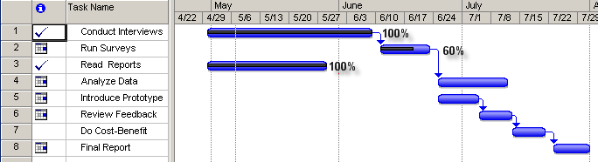
Gantt Chart Example
Blue bars show time periods for tasks
Arrows depict dependencies
Black inner lines and percentages show amount of progress

Slide 18
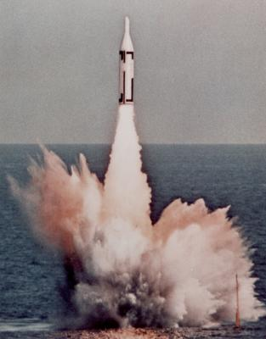
Program Evaluation & Review Technique (PERT)
Developed in 1958 for Polaris missile program
Used extensively in Cold War projects such as CORONA and SR-71
Time estimates, scheduling, and interdependencies of WBS tasks
Visualized in network model

Slide 19
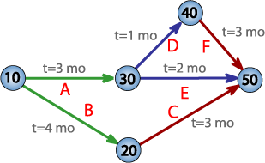
PERT Network
Illustration of WBS with time estimates
Nodes = “mile-stones” (completion of major tasks)
Arcs = “activities” (tasks) with required times

Slide 20
Critical Path Method (CPM)
Similar to PERT (and developed at same time)
Different emphases
  “Critical path”: Longest set of tasks – determines overall time for project
  “Crash” time estimates: Shortest time required in “emergency” situation

Slide 21
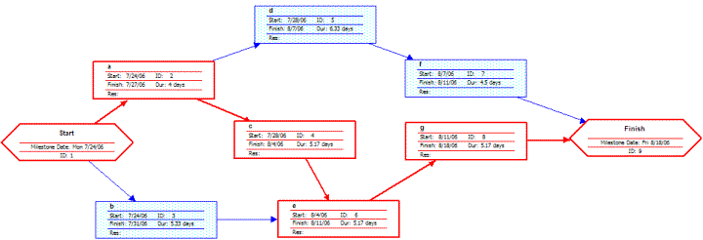
CPM Chart
Time estimates given on nodes
  Including crash times
Critical path highlighted

Slide 22
Implications
Project “Success” can be measured
Can use customer satisfaction as the metric
In business, can use sales
In problem-solving, can establish metrics at each project phase
Can tie goals to metrics
BUT No Child Left Behind

Slide 23

Software
Dozens of programs!
Commercial desktop
  Microsoft Project
  Primavera
Open source
  dotProject
Web-based
  eProject

Slide 24
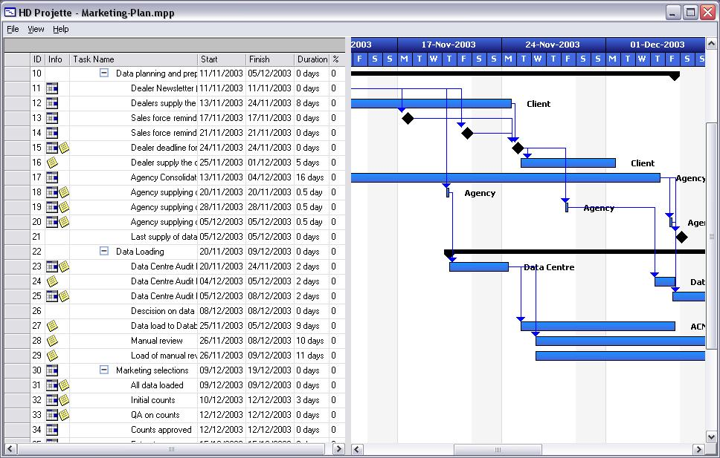
Examples: Projette (add on to MS Project)

Slide 25
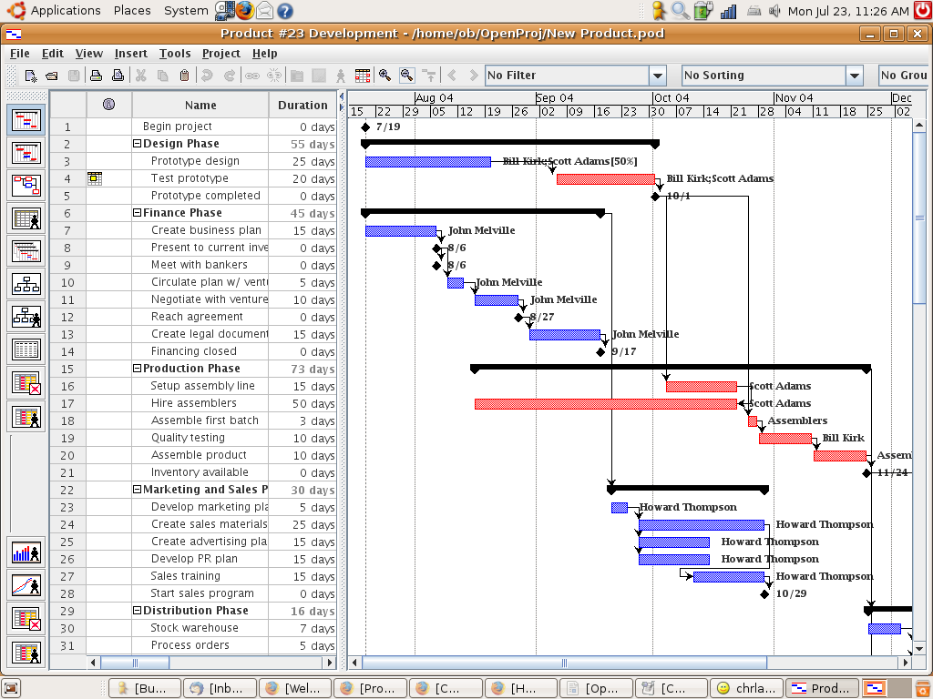
Example: Open Project

Slide 26
Some newer project methods
Brainstorming
Rapid prototyping
Focus groups
Scenario-based planning
SWOT
Red teaming
Delphi methods
Source code control systems
Fault tolerant systems planning

Slide 27
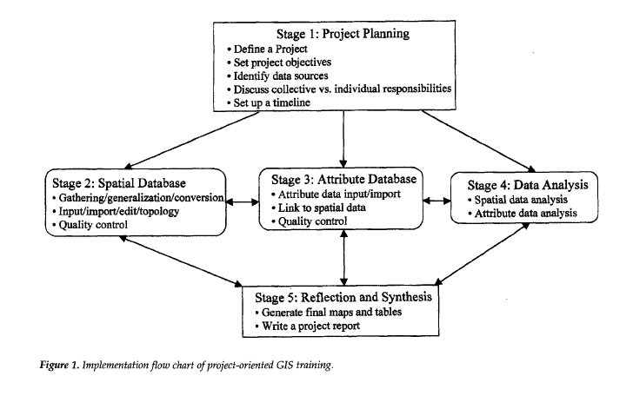
Geog 176C Projects

Slide 28
First stage in project planning
Define a project
Set project objectives
Identify data sources
Discuss collective and individual responsibilities
Set up a timeline

Slide 29
Conclusion
Project Management provides a framework for planning large-scale projects
Tools aid in organizing, scheduling, and visualizing required work
Likely to encounter in your future career

